Slide 1



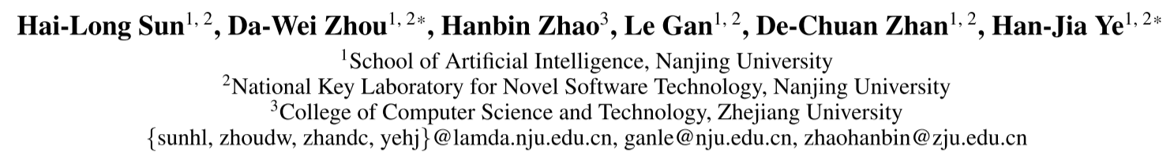





Chongqing University of Technology
ATAI
Advanced Technique of Artificial Intelligence
Chongqing University of Technology
MOS: Model Surgery for
Pre-Trained Model-Based Class-Incremental Learning
Code — https://github.com/sun-hailong/AAAI25-MOS
——AAAl 2025
Reported by HongLiang Nie

Slide 2
Motivation
(1) Class-Incremental Learning (CIL) requires models to continually acquire knowledge of new classes without forgetting old ones. Despite Pre-trained Models (PTMs) have shown excellent performance in CIL, catastrophic forgetting still occurs as the model learns new concepts.
(2)Specifically, iterative updates of the model result in parameter drift, while mistakenly retrieving irrelevant modules leads to the mismatch during inference.

Slide 3
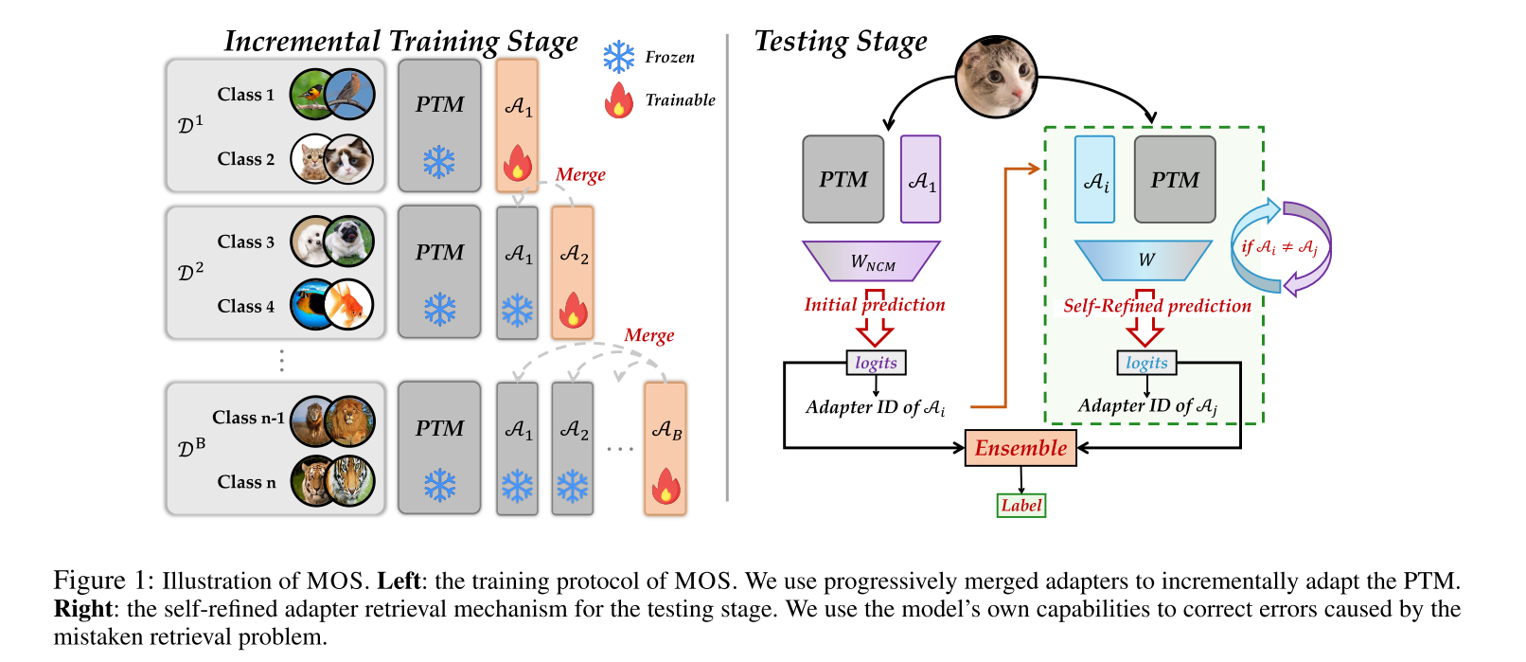
Method

Slide 4

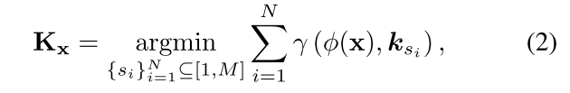
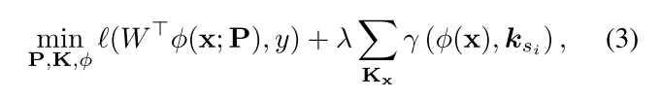
Method

Slide 5



Method

Slide 6



Method

Slide 7
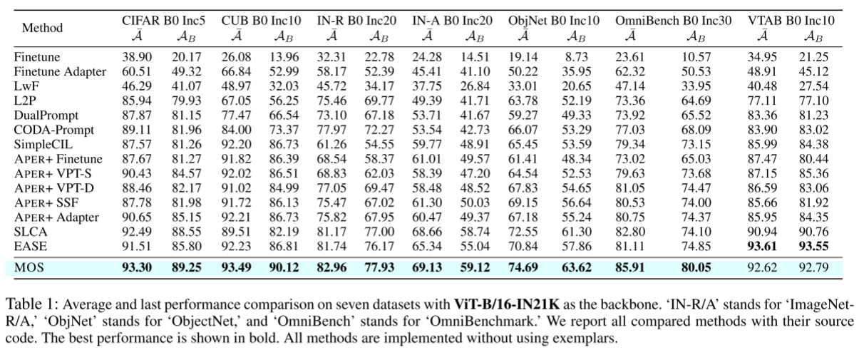
Experiments

Slide 8
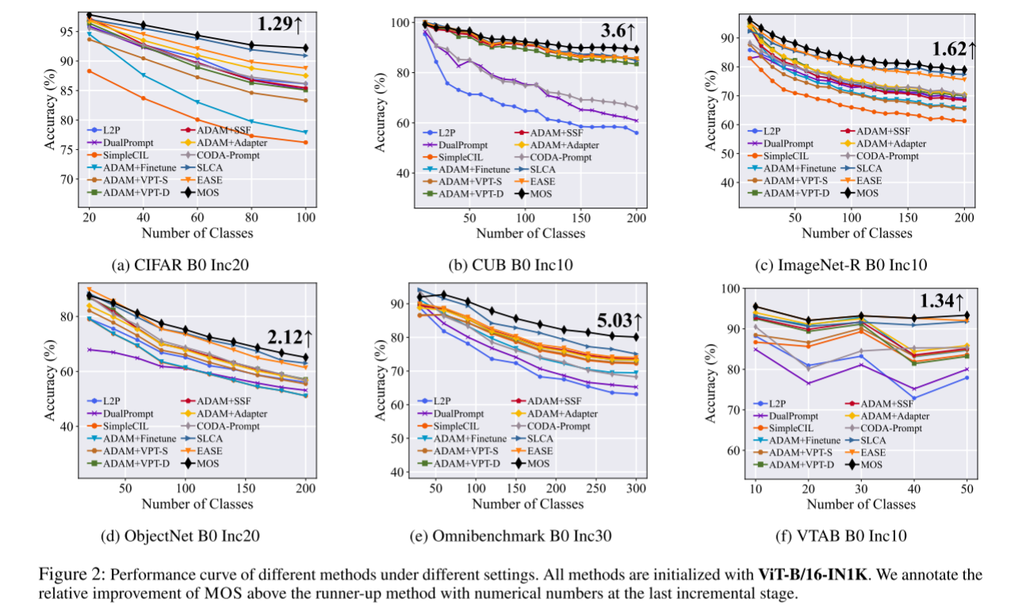
Experiments

Slide 9
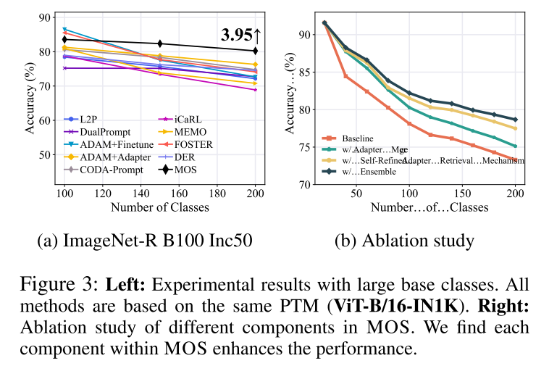
Experiments

Slide 10
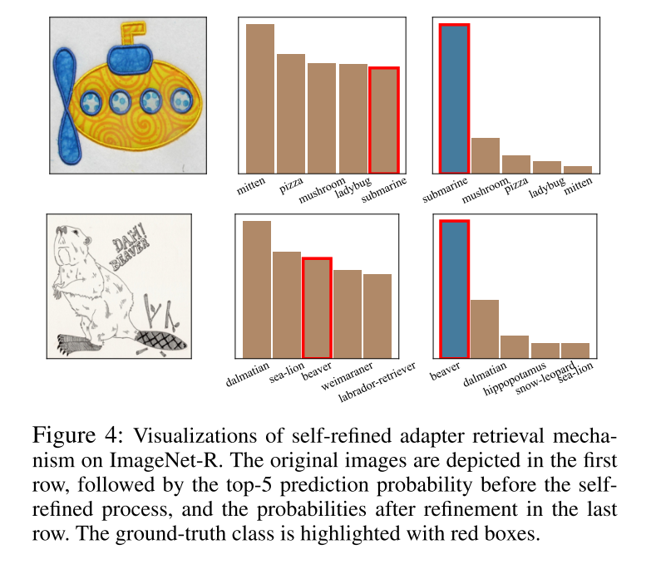
Experiments

Slide 11
Thanks!

